Slide 1
ECE 333 Green Electric Energy
Lecture 14: Wind Energy Conversion Systems (WECS)
Dr. Karl Reinhard
Dept. of Electrical and Computer Engineering
University of Illinois at Urbana-Champaign
reinhrd2@illinois.edu

Slide 2
Announcements
Continue Reading Chapter 7
HW 8 is posted on the website;
Quiz 8 on 5 April
Midterm 2 on 12 April (during class);
Closed book, closed notes;
Bring standard calculator
One 8.5 by 11 inch note sheet that you have prepared

Slide 3
Types of Wind Turbines
“Windmills” are used to grind grain into flour
Many “Wind Turbine” names –
wind-driven generator
wind generator
wind turbine
wind-turbine generator (WTG)
wind energy conversion system (WECS)”
Wind turbines characterized by turbine blade’s axis of rotation
Horizontal axis wind turbines (HAWT)
Vertical axis wind turbines (VAWT)
Groups of wind turbines are located in what is called either a “wind farm” or a “wind park”
Notes:
2

Slide 4
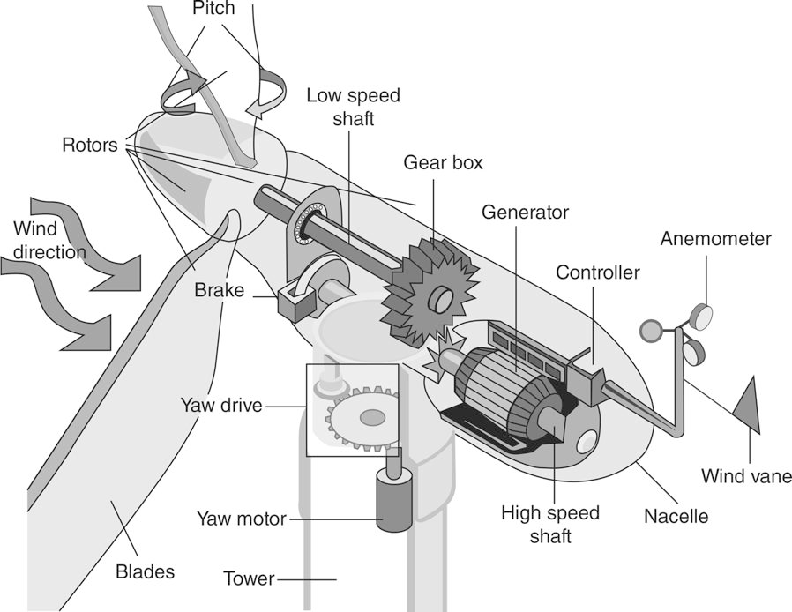
Typical Wind Energy Conversion System Components
FIGURE 7.5 Principal components of most wind energy conversion systems.
Masters, Gilbert M. Renewable and Efficient Electric Power Systems, 2nd Edition. Wiley-Blackwell, 21/06/2013.
Notes:
3

Slide 5
Turbine Blade – an Air Foil
FIGURE 7.7 (a) Lift in wing (b) wind turbine blade forces
Masters, Gilbert M. Renewable and Efficient Electric Power Systems, 2nd Edition. Wiley-Blackwell, 21/06/2013.
FIGURE 7.8 Increasing the angle of attack can cause a wing to stall
Masters, Gilbert M. Renewable and Efficient Electric Power Systems, 2nd Edition. Wiley-Blackwell, 21/06/2013.
Notes:
4

Slide 6
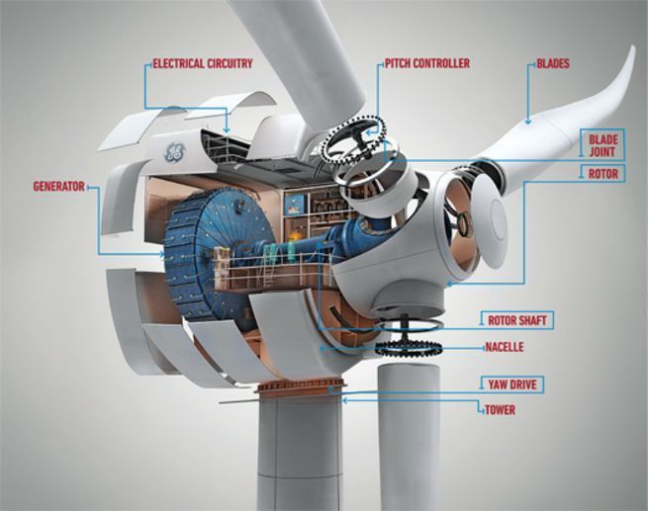
Wind Energy Conversion Systems
H. Kim and D. Lu, "Wind Energy Conversion System from Electrical Perspective—A Survey," Smart Grid and Renewable Energy, Vol. 1 No. 3, 2010, pp. 119-131. doi: 10.4236/sgre.2010.13017.
https://www.popsci.com/technology/article/2010-03/next-gen-wind-turbine

Slide 7
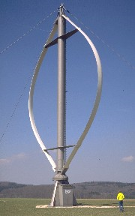
Vertical Axis Wind Turbines
Darrieus rotor - the only commercially successful vertical axis machine
Wind flowing by the vertical blades (aerofoils) generates “force” producing rotation
No yaw (rotation about vertical axis) control needed to keep them facing into the wind
Heavy machinery in the nacelle is located on the ground
Blades are closer to ground where wind-speeds are lower
Notes:
6

Slide 8
Horizontal Axis Wind Turbines (HAWT)
“Downwind” HAWT – turbine blades are downwind of the tower
Advantage: No yaw control needed –blades naturally orient to wind direction
Disadvantages: Tower disrupts the air stream causing turbulence
vibration
mech stress on the blade and supporting structure
Notes:
7

Slide 9
Horizontal Axis Wind Turbines (HAWT)
“Upwind” HAWT – blades face into the wind
Most modern wind turbines are “upwind” configuration
Advantages:
Significantly reduced vibrations… and mechanical stress ($ savings)
deliver more power ($)
Disadvantage: Requires somewhat complex yaw control to maintain orientation facing into the wind
Notes:
8

Slide 10
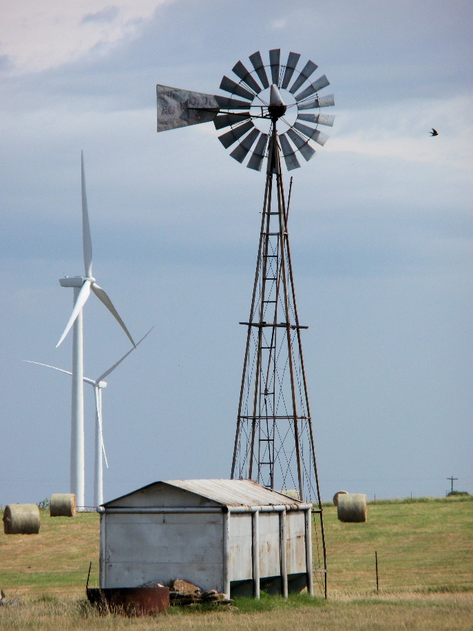
Number of Rotating Blades
Windmills have multiple blades
high starting torque needed to overcome pumping rod weight / inertia
low windspeeds required to provide nearly continuous water pumping
comparatively larger rotor area faces the wind
Turbines with many blades operate at much lower rotational speeds - as the speed increases, the turbulence caused by one blade impacts the other blades
Most modern wind turbines have two or three blades
http://pixelpops.com/public_photos/what.html
Notes:
9

Slide 11
Classifying Wind Energy Conversion Systems
Rotation Speed
Fixed-speed turbines
Variable Speed turbines
Indirect drive (w/gear box)
Direct drive (w/o gear box)
Power Electronics – Wind Generation System w/
No power converter
Partial-capacity power converter
Full-capacity power converter

Slide 12
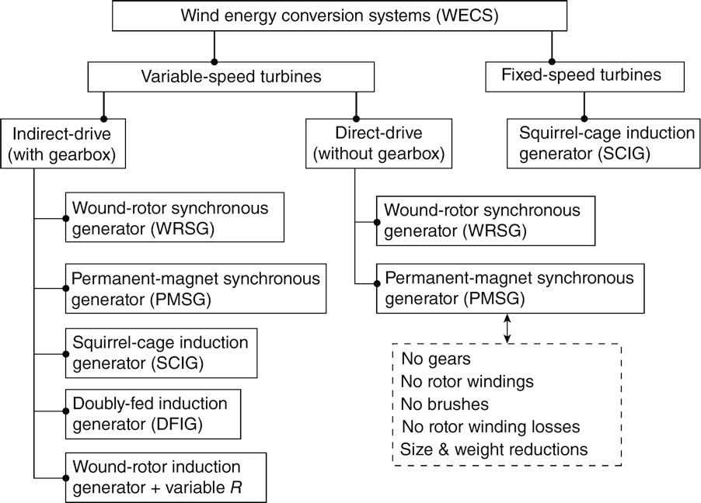
Wind Energy Conversion Systems
FIGURE 7.9 System configurations for wind energy systems.
Masters, Gilbert M. Renewable and Efficient Electric Power Systems, 2nd Edition. Wiley-Blackwell, 21/06/2013.
Notes:
11

Slide 13
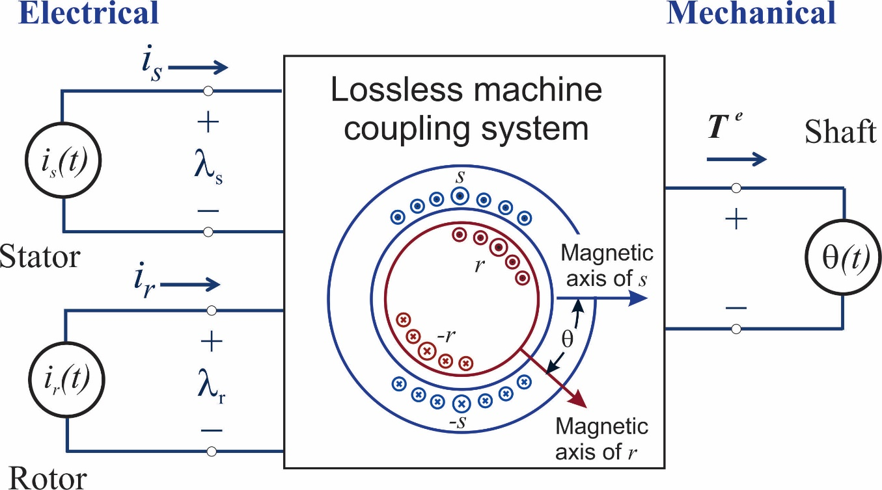
Machine Conditions: Elect-Mech Power Conversion
Adapted from Fig 4.1.6, H. H. Woodson and J. R. Melcher, Electromechanical Dynamics Part I: Discrete Systems, John Wiley & Sons, Inc., New York, 1968.
A general machine is excited by ideal sources

Slide 14
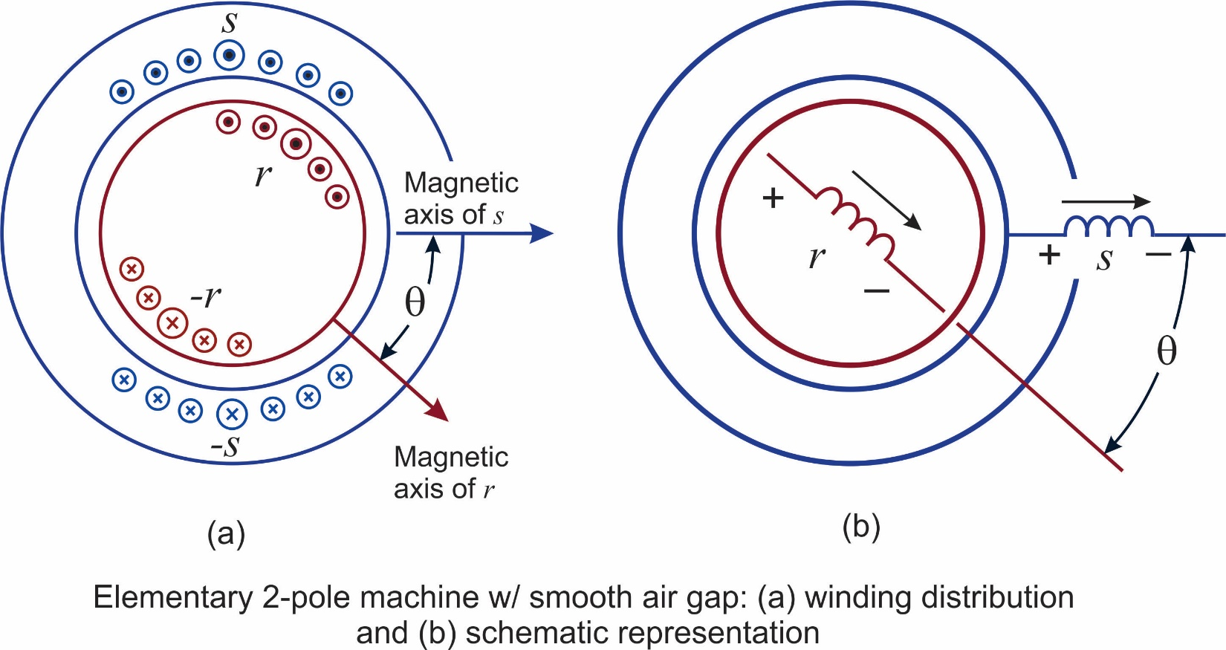
Machine Conditions for Average Power Conversion
Adapted from Fig 4-34, A. E. Fitzgerald, C. Kingsley, and S. D. Umans, Electric Machinery, 5th ed, McGraw-Hill Book Co., New York, 1990.
Instantaneous power
Substitution

Slide 15
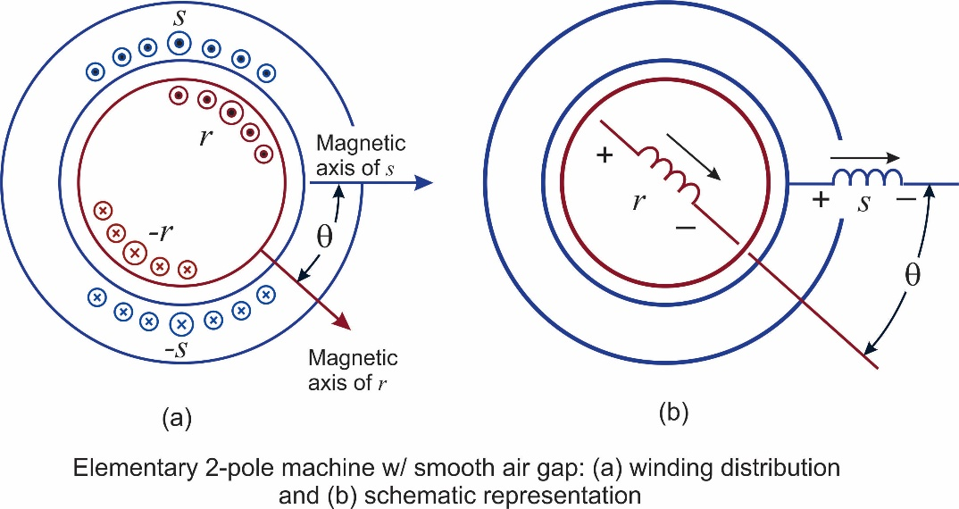
Machine Conditions for Average Power Conversion
Adapted from Fig 4-34, A. E. Fitzgerald, C. Kingsley, and S. D. Umans, Electric Machinery, 5th ed, McGraw-Hill Book Co., New York, 1990.
Trig manipulation →
Because a sinusoidal time function has no average value, ${<p}_{m}>≠0$ when a coefficient of $t=0$

Slide 16
Machine Conditions for Average Power Conversion
Hence 4 frequency conditions for average power conversion can
be compactly written
→ A key element of machine theory is satisfying the frequency condition with the available electrical & mechanical sources to match machine characteristics with the application

Slide 17
Synchronous Machines
Spin at a fixed rotational speed ($ω_{m})$ determined by the number of poles and by the frequency, e.g.
3600 rpm @ 60Hz, 2 pole
1800 rpm @ 60Hz, 4 pole (explained next slide)
The stator magnetic field matches system frequency ($ω_{s}=2π∙60$)
Create the rotor magnetic field w/ direct current ($ω_{r}$= 0) on the rotor windings
Slip rings are needed to make the dc current connection on the rotor
Permanent magnets are an alternative
A gear box often needed between the blades and the generator
Some newer machines are designed without a gear box

Slide 18
Magnetic Poles
Synchronous speed depends on the electrical frequency and the number of poles, with
Image source :cnx.org/contents/cbb3bd3b-430a-487b-9c53-b17d79e3367c@1/Chapter_5:_Synchronous_Machine

Slide 19
Asynchronous Induction Machines
Spins at a variable speed ($ω_{r}≠ω_{s}$)
Acts as a motor during start up; can act as a generator when spun faster then synchronous speed
Does not require exciter, brushes, and slip rings
Less expensive
Require less maintenance
The magnetic field is created on the stator not the rotor
Current is induced in the rotor (Faraday's law: v= dλ/dt)
Lorenz force on wire with current in magnetic field:

Slide 20
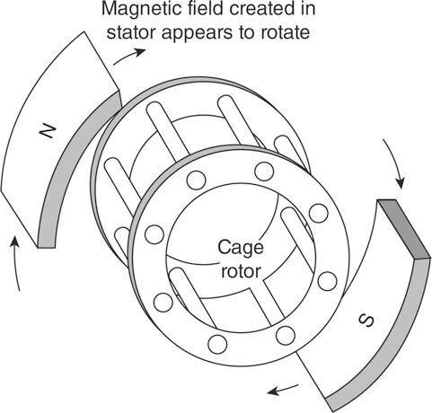
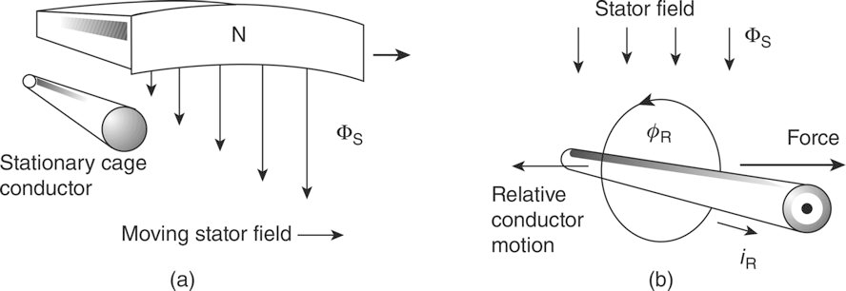
Squirrel-Cage Induction Generator
FIGURE 7.10 Squirrel-Cage Induction Generator
Masters, Gilbert M. Renewable and Efficient Electric Power Systems, 2nd Edition. Wiley-Blackwell, 21/06/2013.
FIGURE 7.11 Cage Conductor Force & Current
Masters, Gilbert M. Renewable and Efficient Electric Power Systems, 2nd Edition. Wiley-Blackwell, 21/06/2013.
Notes:
19

Slide 21
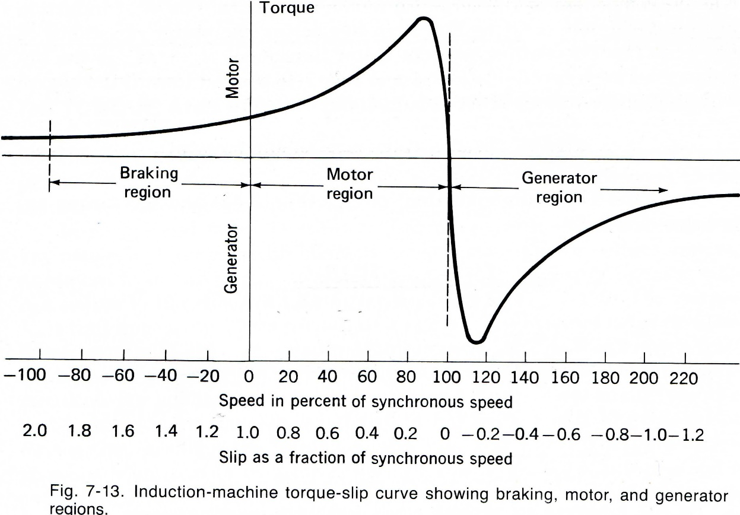
The Inductance Machine as a Motor
Fig 7-13, A. E. Fitzgerald, C. Kingsley, and S. D. Umans, Electric Machinery, 5th ed, McGraw-Hill Book Co., New York, 1990.
$ω_{m}=ω_{s}±ω_{r}$
Rotating stator magnetic field causes rotor to spin in the same direction
As rotor approaches $ω_{s}$, the relative motion becomes less and less
If $ω_{s}=ω_{m}$, no relative motion, I = 0, and no force
Thus in an induction motor $ω_{m}<ω_{s}$

Slide 22
Slip
Slip captures the difference between the stator and the rotor speeds
s = rotor slip – positive for a motor, negative for a generator
N_{S} = no-load synchronous speed (rpm)
f = frequency (Hz)
P = number of poles
N_{R} = rotor speed (rpm)
$N_{s}=\frac{120f}{P}$

Slide 23
The Induction Machine as a Generator
Fig 7-13, A. E. Fitzgerald, C. Kingsley, and S. D. Umans, Electric Machinery, 5th ed, McGraw-Hill Book Co., New York, 1990.
External mechanical force causes rotation exceeding electrical speed ($ω_{m}>ω_{s}$)
Slip becomes negative
Power transferred from mechanical to electrical

Slide 24
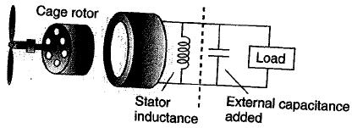
The Induction Machine as a Generator
The stator requires excitation current
from the grid if it is grid-connected or
by incorporating external capacitors
Single-phase, self-excited, induction generator
Wind speed forces generator shaft to exceed synchronous speed

Slide 25
The Induction Machine as a Generator
Slip is negative because the rotor spins faster than synchronous speed
Slip is normally less than 1% for grid-connected generator
Typical rotor speed

Slide 26
Speed Control
Necessary to be able to shed wind in high-speed winds
Rotor efficiency changes for different Tip-Speed Ratios (TSR), and TSR is a function of windspeed
To maintain a constant TSR, blade speed should change as wind speed changes
A challenge is to design machines that can accommodate variable rotor speed and fixed generator speed

Slide 27
Blade Efficiency vs. Windspeed
At lower windspeeds, the best efficiency is achieved at a lower rotational speed

Slide 28
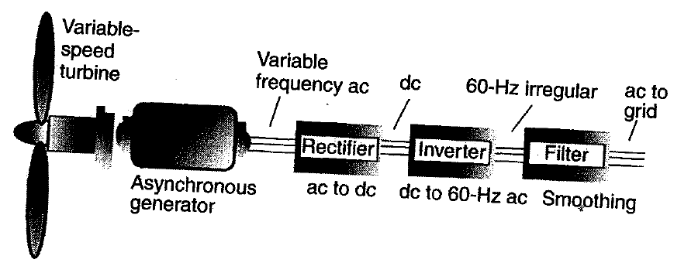
Indirect Grid Connection Systems
Wind turbine is allowed to spin at any speed
Variable frequency AC from the generator goes through a rectifier (AC-DC) and an inverter (DC-AC) to 60 Hz for grid-connection
Good for handling rapidly changing windspeeds

Slide 29
Wind Turbine Gearboxes
A significant portion of the weight in the nacelle is due to the gearbox
Needed to change the slow blade shaft speed into the higher speed needed for the electric machine
Gearboxes require periodic maintenance (e.g., change the oil), and have also be a common source of wind turbine failure
Some wind turbine designs are now getting rid of the gearbox by using electric generators with many pole pairs (direct-drive systems)

Slide 30
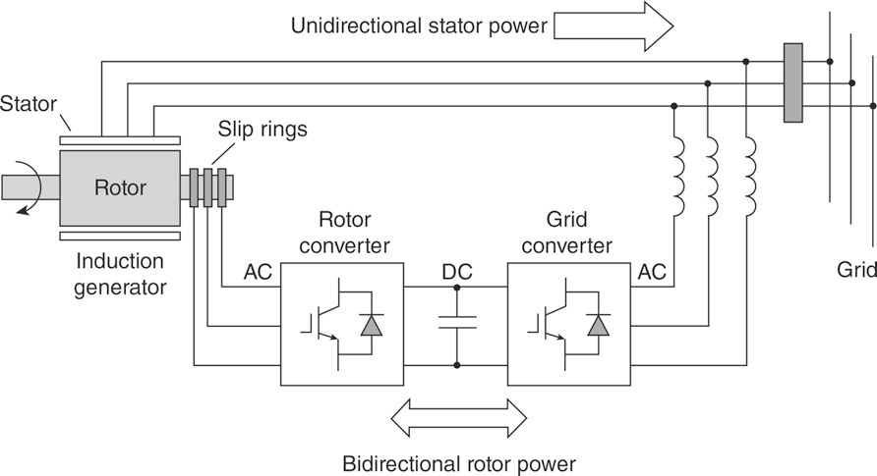
Doubly-fed Induction Generator (DFIG)
FIGURE 7.12 A wound-rotor, doubly-fed induction generator (DFIG)
Masters, Gilbert M. Renewable and Efficient Electric Power Systems, 2nd Edition. Wiley-Blackwell, 21/06/2013.
Notes:
29

Slide 31
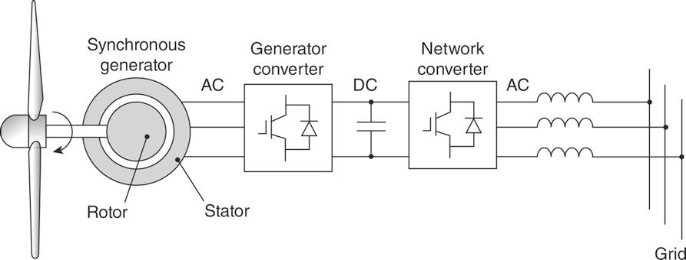
Gearless Variable-Speed Synchronous Generator
FIGURE 7.13 A gearless variable-speed synchronous generator.
Masters, Gilbert M. Renewable and Efficient Electric Power Systems, 2nd Edition. Wiley-Blackwell, 21/06/2013.
Notes:
30

Slide 32
Types of Wind Turbines by Machine
From an electric point of view there are four main types of large-scale wind turbines (IEEE naming convention)
Type 1: Induction generator with fixed rotor resistance
Type 2: Induction generators with variable rotor resistance
Type 3: Doubly-fed induction generators
Type 4: Full converter generators which main use either a synchronous generator or an induction generator
Most new wind turbines are either Type 3 or Type 4
In Europe these are sometimes called Types A, B, C, D respectively.

Slide 33
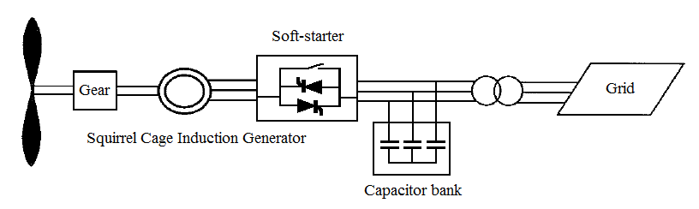
IEEE Type 1 (Induction w/ Fixed Rotor R)
Induction generator connected with a fixed rotor resistance
Design requires additional components for grid connection:
Soft-starter to decrease current transients during startup phase
Capacitor bank to compensate for reactive power.
Capacitor bank enables the generator can work close to 0 value generation and 0 reactive power consumption.
This compensation approach does not provide flexible reactive power control
Notes:
32

Slide 34
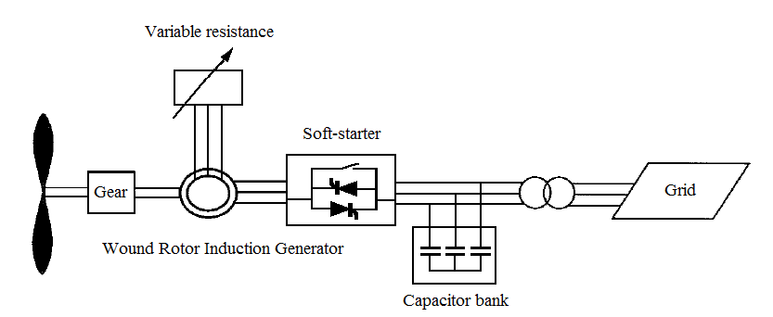
IEEE Type 2 (Induction w/ Variable Rotor R)
Type B WECS generator is designed to work with limited variable speed wind turbine
Variable resistor in the machine rotor, enables controlled-power output
Capacitor bank and soft-starter are analogous to the type A design
Notes:
33

Slide 35
IEEE Type 3 (Doubly-fed Induction Generator)
WECS control enabled by two AC/DC converters w/ a connecting capacitor
Wound rotor induction generator – known as a doubly fed induction generator (DFIG)
“Doubly” as the rotor winding is not short-circuited (as in classical “singly-fed” induction machine); voltage is induced from the rotor-side converter
2 operating schemes: constant (1) reactive power or (2) voltage
Most commonly installed WECS
Notes:
34

Slide 36
IEEE Type 4 (Var. Speed w/ Full Pwr Elect Conv.)
Type D design includes full-scale frequency converter with different generator types.
Most common – permanent magnet synchronous generator (PMSG).
This design enables
full active / reactive power production control
high wind energy extraction value
Full power control improves power and frequency stability and reduces the short circuit power.
Most type D designs do not need a gearbox – a distinct advantage
Notes:
35

Slide 37
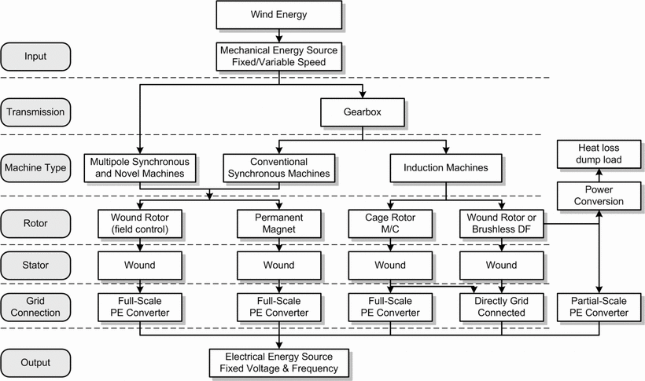
Another Classification Taxonomy
F. Iov and F. Blaabjerg, "Power electronics and control for wind power systems," 2009 IEEE Power Electronics and Machines in Wind Applications, Lincoln, NE, 2009, pp. 1-16. doi: 10.1109/PEMWA.2009.5208339

Slide 38
Announcements
No Homework / Quiz this week
Homework 7 Posted
Quiz 7 Thursday after Spring Break
Reading Chapter 7
Thanks to EOH Volunteers – GREAT SUCCCESS
Spring Break Safety !!

